Slide 1


Cloth Rental Shop Website
A platform for renting stylish clothes​
Presented by: Amruta & Kiran

Slide 2
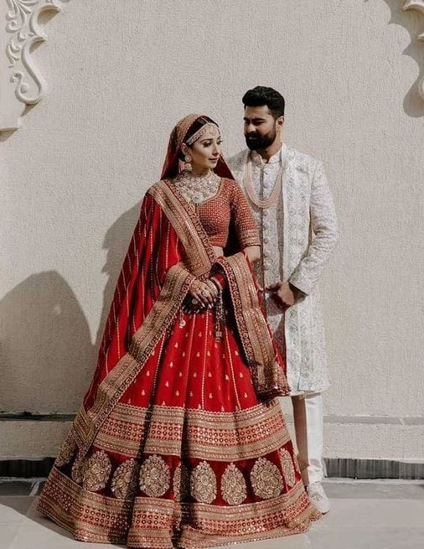
Introduction
"Our Cloth Rental Shop Website is designed to help users easily rent fashionable clothing for various occasions. Whether it's a wedding, a formal event, or a casual outing, our platform connects users with high-quality garments at affordable prices."

Slide 3

HTML: The Backbone
HTML (HyperText Markup Language) builds the structure of our website. It allows us to organize content and ensure it's readable by browsers and search engines.

Slide 4
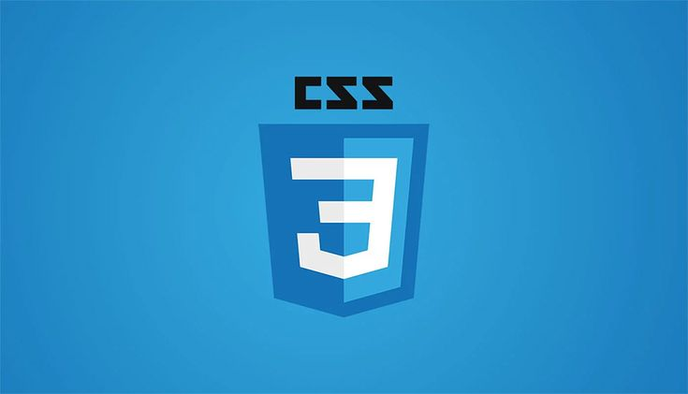
CSS: The Style
CSS controls how HTML elements appear, helping us design a responsive and visually appealing user interface.
Use of selectors to style text, borders, spacing, and layout
Media queries to ensure mobile responsiveness (@media)

Slide 5

JavaScript: The Interaction
JavaScript makes the site interactive and dynamic, ensuring users can interact smoothly with the platform.
Real-time form validation (e.g., password match or email format check)
Toggle menus, sliders, and modal popups for better UI/UX
AJAX for dynamic content loading without page refresh

Slide 6

PHP: The Server-side Logic
PHP processes data, manages sessions, and connects to databases. It's the brain behind the site.
Store and retrieve items from a MySQL database
Generate dynamic content based on user roles or search queries

Slide 7
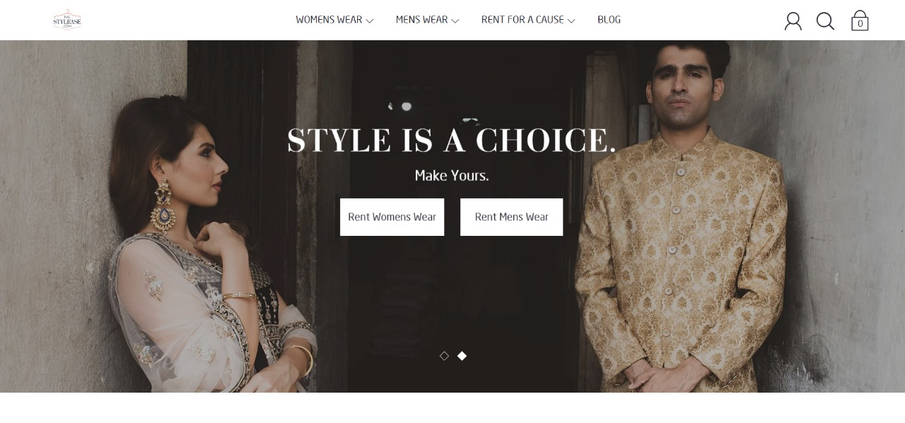

Slide 8
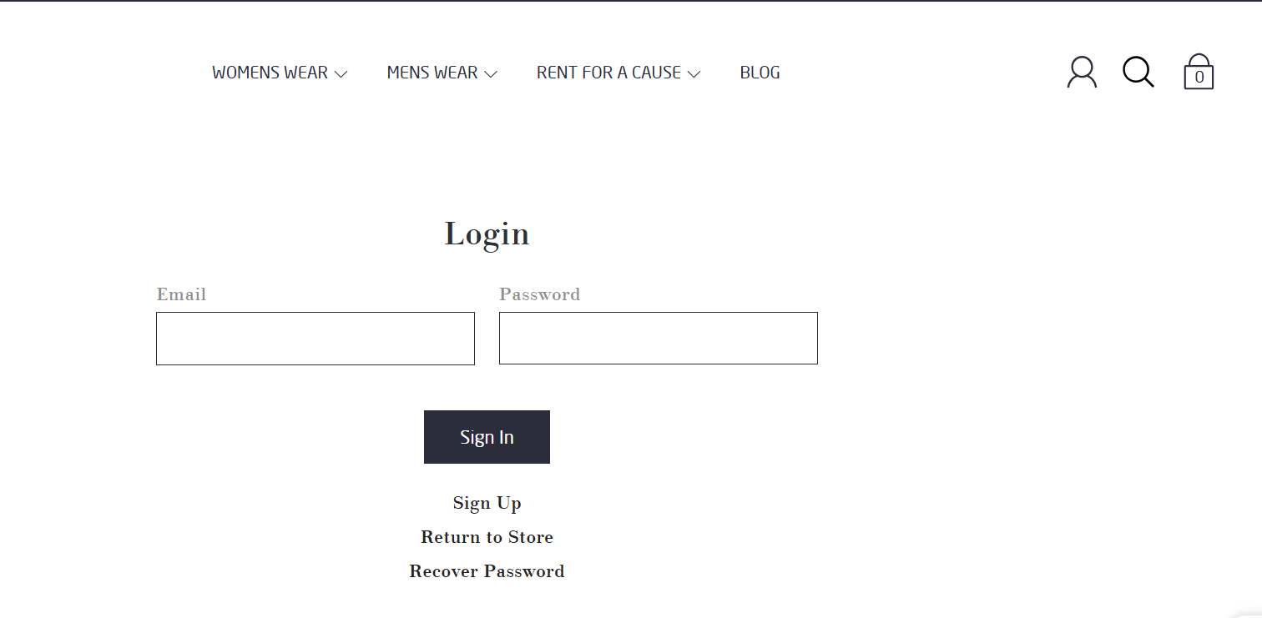

Slide 9
Thank you

